Slide 1
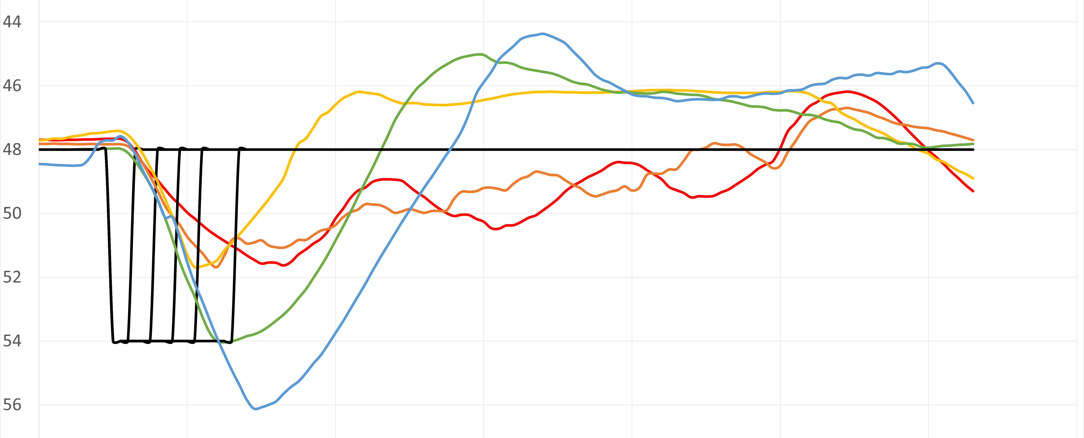





Θ
46
$$t_{b}=128ms$$
$$t_{b}=96ms$$
$$t_{b}=160ms$$
44
42
40
$$t_{b}=64ms$$
38
$$t_{b}=32ms$$
36
34

